Slide 1
Introduction to Physics and Colliders
Notes:
• Brief overview of the importance of physics in game development.
• Introduction to Unity's built-in physics engine and the role of colliders.

Slide 2
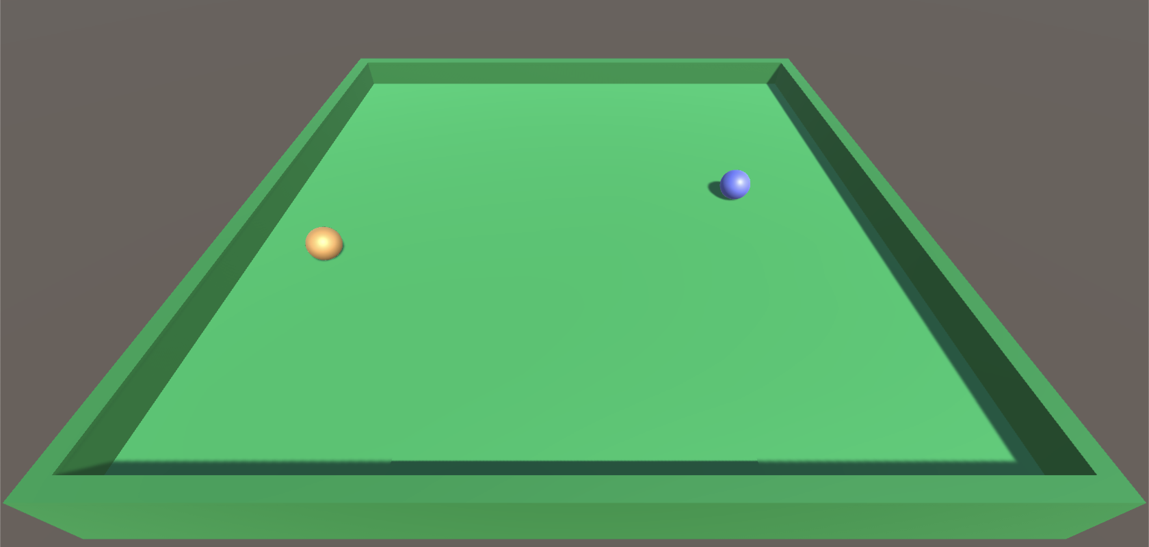
Learning Objectives
Understand the basics of physics simulation in Unity.
Learn about colliders and their role in collision detection.
Grasp how to implement basic physics interactions in Unity.

Slide 3
Importance of Physics in Games
1. Realism Enhancement:
Simulation of Real-World Behavior: Physics engines replicate real-world physics, making objects interact realistically with the environment (gravity, friction, collisions, etc.).
Environmental Interactions: Realistic physics create immersive worlds where objects behave as expected, enhancing the player's sense of immersion and believability (Collisions and Interactions, Dynamic Materials).
2. Improving Interactivity:
Dynamic Interactions: Physics engines enable dynamic interactions between game elements, allowing for emergent gameplay and unscripted events.
Player Agency: Physics-based mechanics give players more control and freedom, enabling creative problem-solving and varied gameplay approaches.
5: Thorn, Alan, Pro Unity game development with C#, 2014
8: Unity Technologies, Unity Manual, 2023
Notes:
• Definition of scenes as individual levels, environments, or segments of a game.
• Explanation of how scenes contribute to the overall structure and flow of a game project.

Slide 4
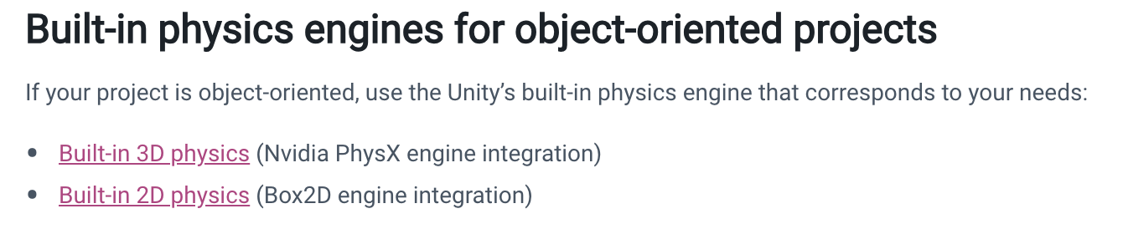
Unity's Built-in Physics Engine
Unity helps you simulate physics in your Project to ensure that the objects correctly accelerate and respond to collisions, gravity, and various other forces. Unity provides different physics engine implementations which you can use according to your Project needs: 3D, 2D, object-oriented, or data-oriented. ^{[8]}
For developers working with game engines, physics engines provide an accompanying way of simulating real-world responses for objects in games. In Unity, the game engine uses Nvidia's PhysX engine, a popular and highly accurate commercial physics engine. ^{[10]}
8: Unity Technologies, Unity Manual, 2023
10: Goldstone Will, Unity 3.x game development essentials, 2011

Slide 5
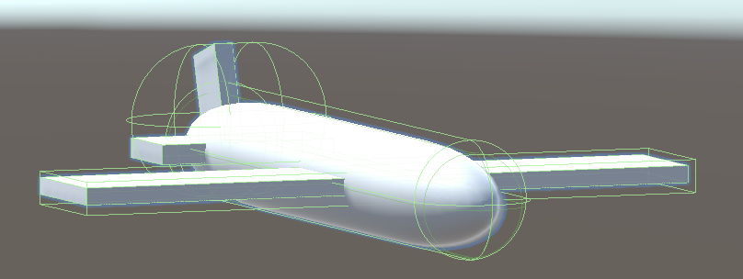
What are Colliders?
In Unity, colliders are components used to define the shape and boundaries of objects for the purposes of collision detection within the physics simulation. They enable the interaction and detection of collisions between GameObjects in a 3D or 2D space.

Slide 6
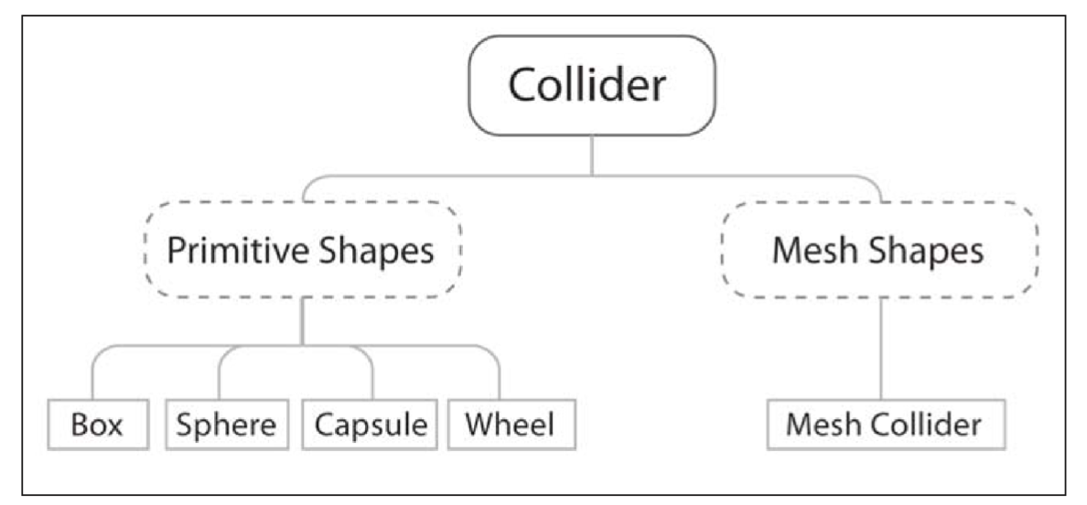
Common Types of Colliders
There are two main types of Collider in Unity—Primitives and Meshes
Primitive shapes in 3D terms are simple geometric objects such as Boxes, Spheres, and Capsules. Often, Primitive colliders are used because they are computationally cheaper or because there is no need for precision
A Mesh collider is more expensive as it can be based upon the shape of the 3D mesh it is applied to; therefore, the more complex the mesh, the more detailed and precise the collider will be, and more computationally expensive it will become
10: Goldstone Will, Unity 3.x game development essentials, 2011

Slide 7
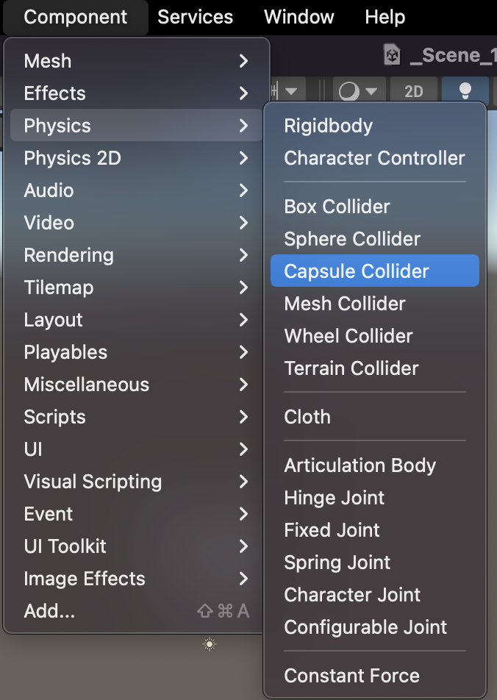
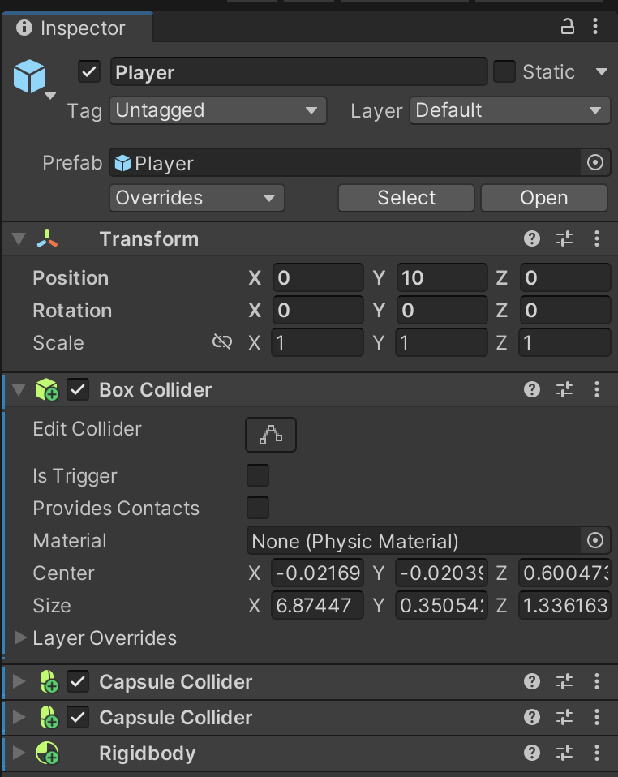
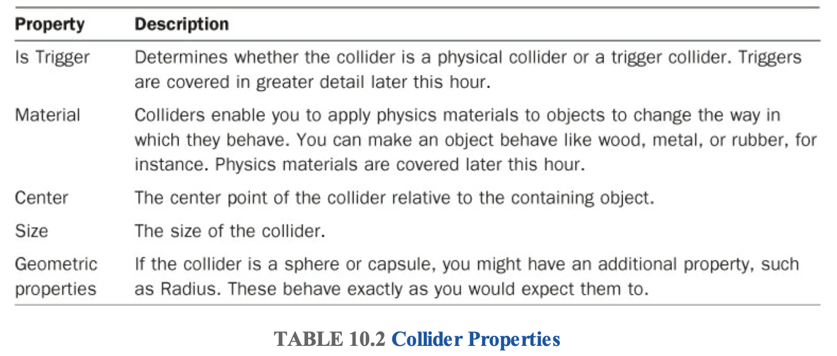
Attaching Colliders to Game Objects
Select GameObjet in Hierachi, add a collider to object by clicking Component > Physics and then choosing the collider shape you want from the menu

Slide 8
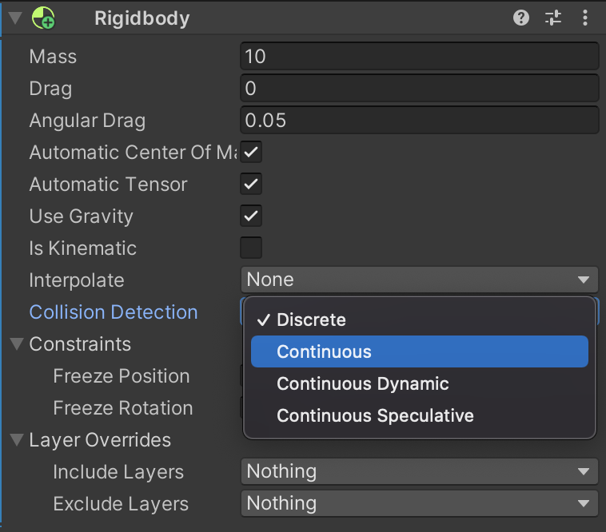
Collision Detection Basics
Continuous collision detection (CCD) ensures that fast-moving bodies collide with objects instead of passing, or tunnelling, through those objects. Unity provides the following CCD methods:
Sweep-based CCD
Speculative CCD
To use sweep-based CCD, select a RigidBody in the Inspector window and set Collision Detection to Continuous or Continuous Dynamic.
For speculative CCD, set Collision Detection to Continuous Speculative.
Notes:
Sweep-based CCD: giả lập việc di chuyển đối tượng từ vị trí cũ đến vị trí mới, kiểm tra va chạm dọc theo đường đi (sweep) để xác định nơi và thời điểm va chạm xảy ra. Chính xác cao, tốn tài nguyên
Speculative CCD: dự đoán sự va chạm trước khi nó xảy ra. Thay vì kiểm tra toàn bộ quá trình di chuyển, nó dự đoán và kiểm tra chỉ những vùng có thể xảy ra va chạm. Hiệu suất cao, chính xác vừa đủ

Slide 9
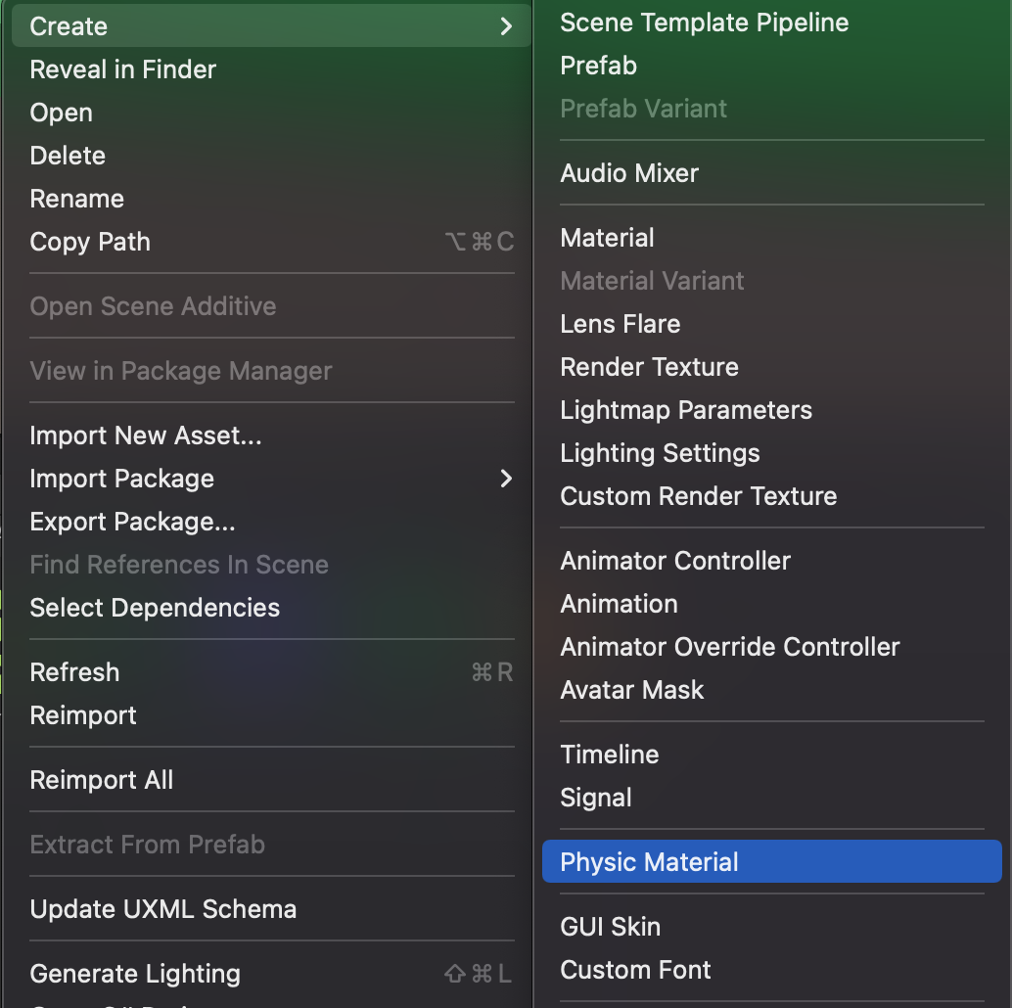
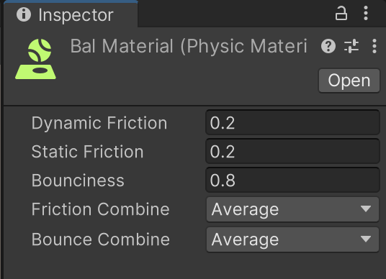
Physics Materials
A material is a packet of information that defines the surface properties (color, shininess, and so forth) of any object that it’s attached to. Defining surface properties separately enables multiple objects to share a material (all the castle walls, for example).
Notes:
https://docs.unity3d.com/Manual/class-PhysicMaterial.html

Slide 10
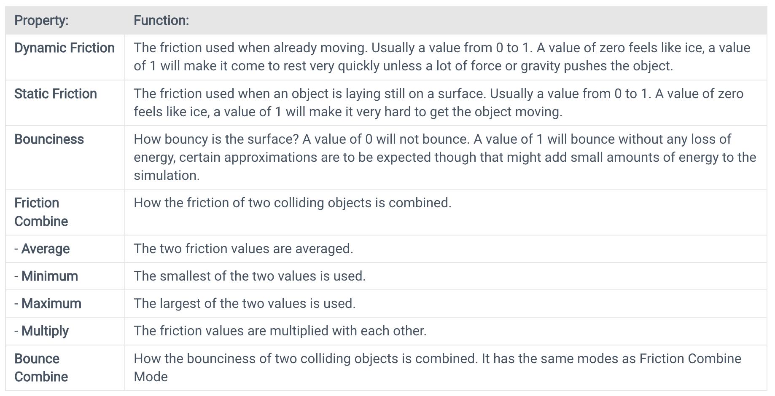
Physics Material - Properties

Slide 11
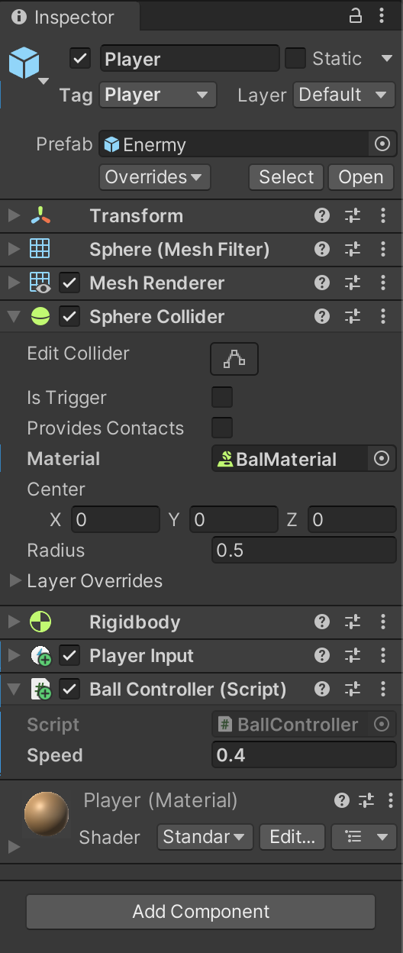
Physics Materials
Add Physics Materials to GameObject
Create a Physic Material: Go to Assets > Create > Physic Material. Give it a name and set its friction, bounciness, and other physical properties as needed.
Assigning to a Collider: Select the GameObject with the Collider component you want to apply the Physic Material to.
OR Drag the Physic Material: Drag the Physic Material onto the Collider component in the Inspector window. Alternatively, you can click and drag the Physic Material from the Project window onto the Collider component in the Inspector.
This applies the physical properties defined in the Physic Material to the Collider of the GameObject, affecting its behavior in the physics simulation within the Unity scene..

Slide 12
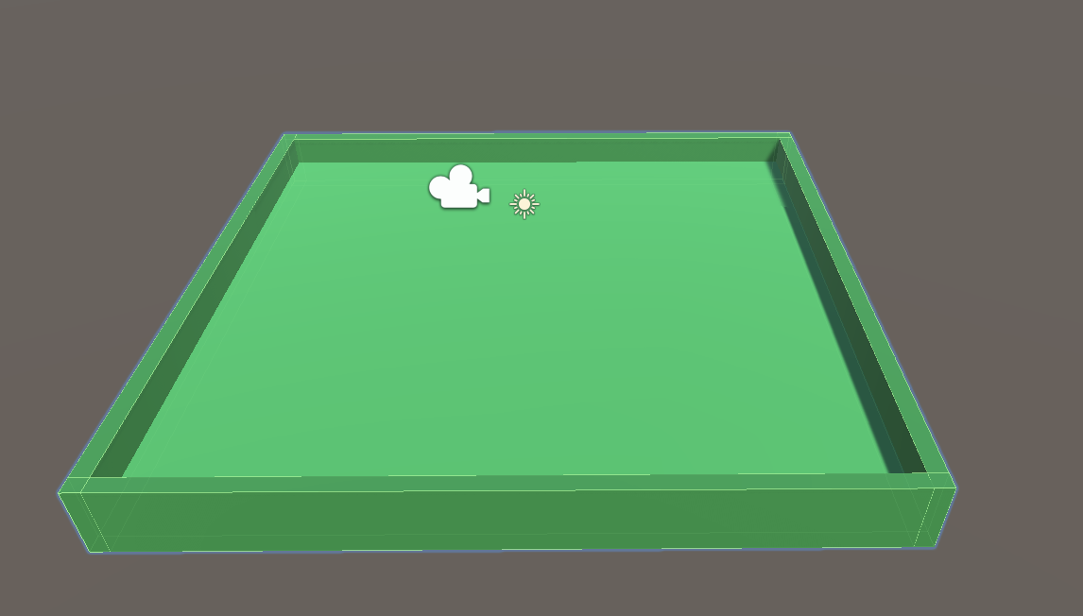
Practical Exercise
Implement colliders, integrate assets, and set up the necessary components in the Unity project to enhance the physics interactions, particularly concerning the Player GameObject.
A. Create the Board (box/table)
1. Create a plane for the Board
2. Create a cube for one of the bumpers.
3. Size and position it so it acts like a rim/bumper. Do this for each side of the table.
4. Create an empty GameObject and rename it to 'Board'. Drag and drop all parts of the board to the new GameObject (so it becomes a child of the empty object).
Notes:
For student: Open the file in:./Media/1.5-Ball-Board-Game-final-demo.mp4 to show the target of this practice.
Students need to follow the next slide's instructions to practice with Unity.
Practice Resources sharing:
https://drive.google.com/drive/folders/1eXu20cX1o-5uMFuSeHGxRS5AkhDZJTOP?usp=sharing
For lecturer: open file in: ./Lecturer-Guide/1.5-Lecturer-Guide.mp4
And user Assets file in ./Lecturer-Guide/Assets/1.5-BallBoard-game/*
To create the final project.

Slide 13
Practical Exercise
B. Create Player and Enermy (2 balls on the table)
1 Create a sphere. Scale it to the size you want for a ball. Place it slightly over the table.
2. With the sphere selected, in the inspector, click 'add component' and add a 'rigidbody'. This will make it use physics.
3. In the Hierarchy select create and then 'new physics material'. Set Dynamic friction to 0.2 Static Friction to 0.2, Bouncyness to 0.8. (Play with these later to get it all right)
4. Drag the new physics material and drop it on the sphere.
5. Duplicate the sphere and drag one of them a bit away along the Z axis.

Slide 14
Practical Exercise
C. Add Player Control Script (Unity InputSystem)
1. Add the inputSystem component to the player.
2. Add a C# script to control the player object.

Slide 15
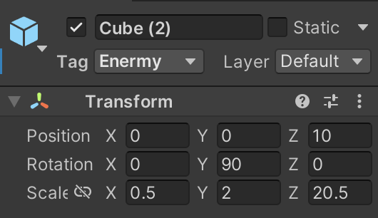
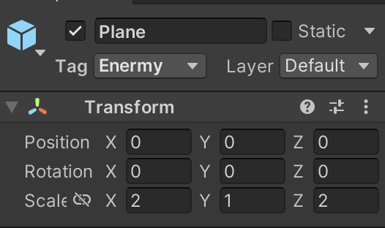
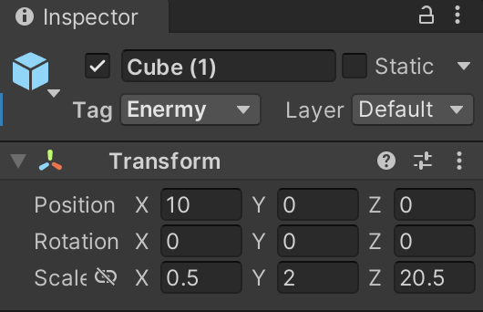
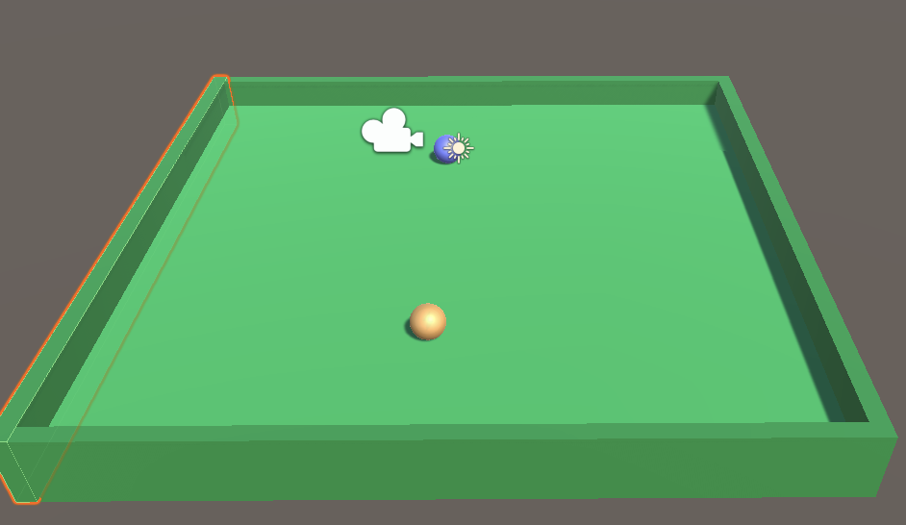
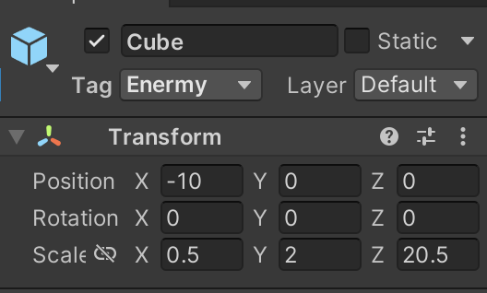
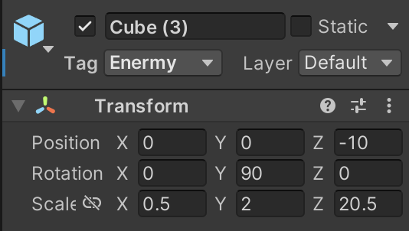
Practical A
Add a plane and a cube. Resize these objects to make the Board and its first wall.
Make another wall of the board by duplicating the cube into three cubes.

Slide 16
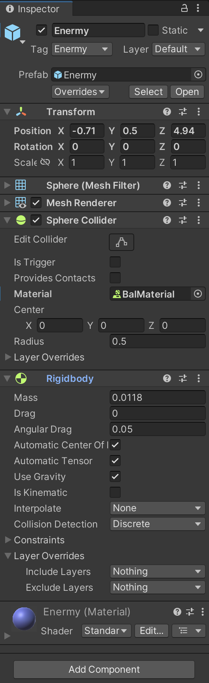
Practical B
Create first ball and add rigidbody, Physic Material, Material (color)
Create sphere and update transform. Rename sphere to Enermy.
Add rigidbody component

Slide 17
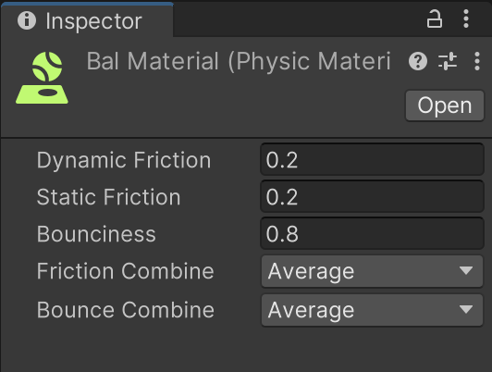
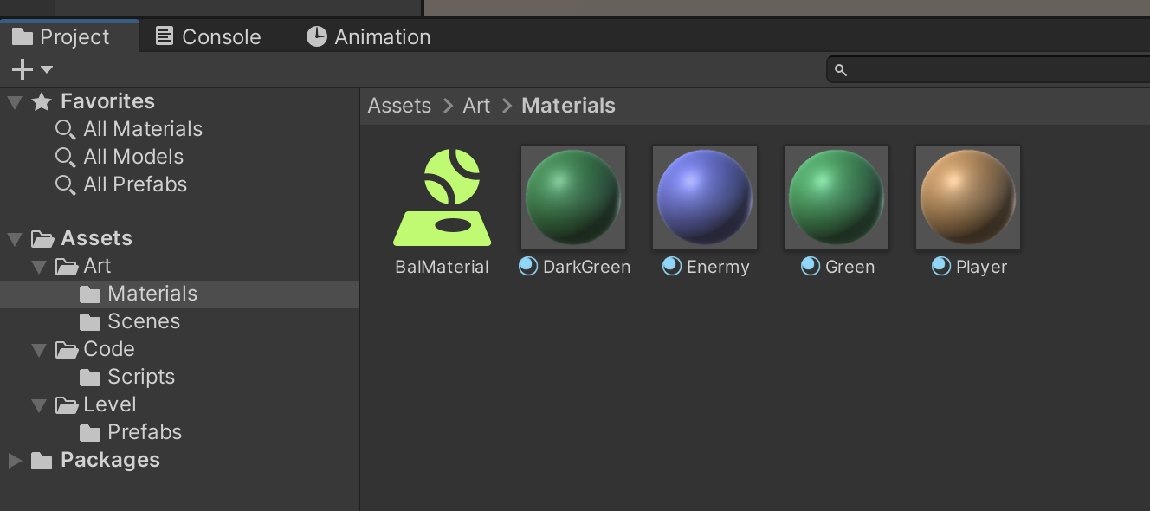
Practical B
Create first ball and add rigidbody, Physic Material, Material (color)
Select Asset > Create > Physic Material. Rename it to BalMaterial.
Set Dynamic friction to 0.2 Static Friction to 0.2, Bouncyness to 0.8.

Slide 18
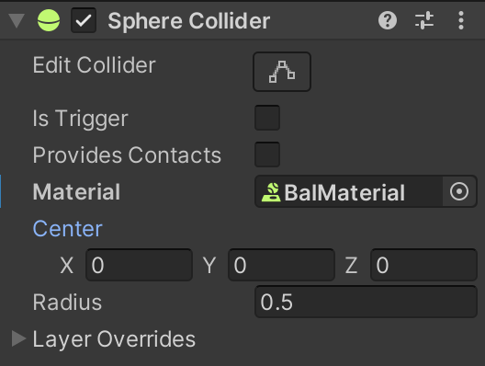
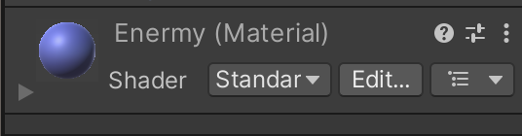
Practical B
Create first ball and add rigidbody, Physic Material, Material (color)
Assign physic material by drag and drop physic material to Collider component of GameObject.
Select Assets > Create > Material. Change Albedo (color) of Material. Drag and drop Material to GameObject.
Duplicate Enermy and rename new GameObject to ‘Player’. Create and change marterial for Player.

Slide 19
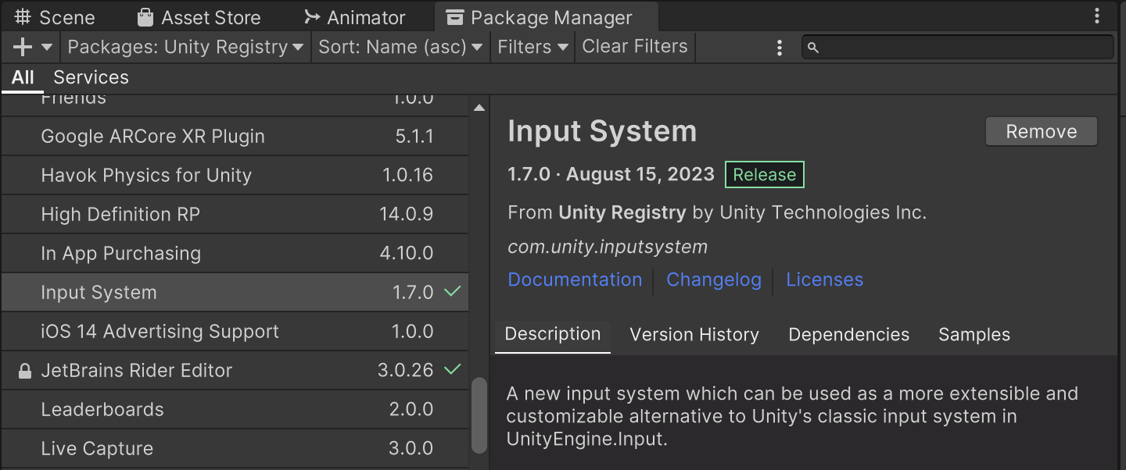
Practical C
Import Unity Input System package to your project.
Open Package Manager panel, make sure you select Unity Registry.
Find and import ‘Input System’

Slide 20
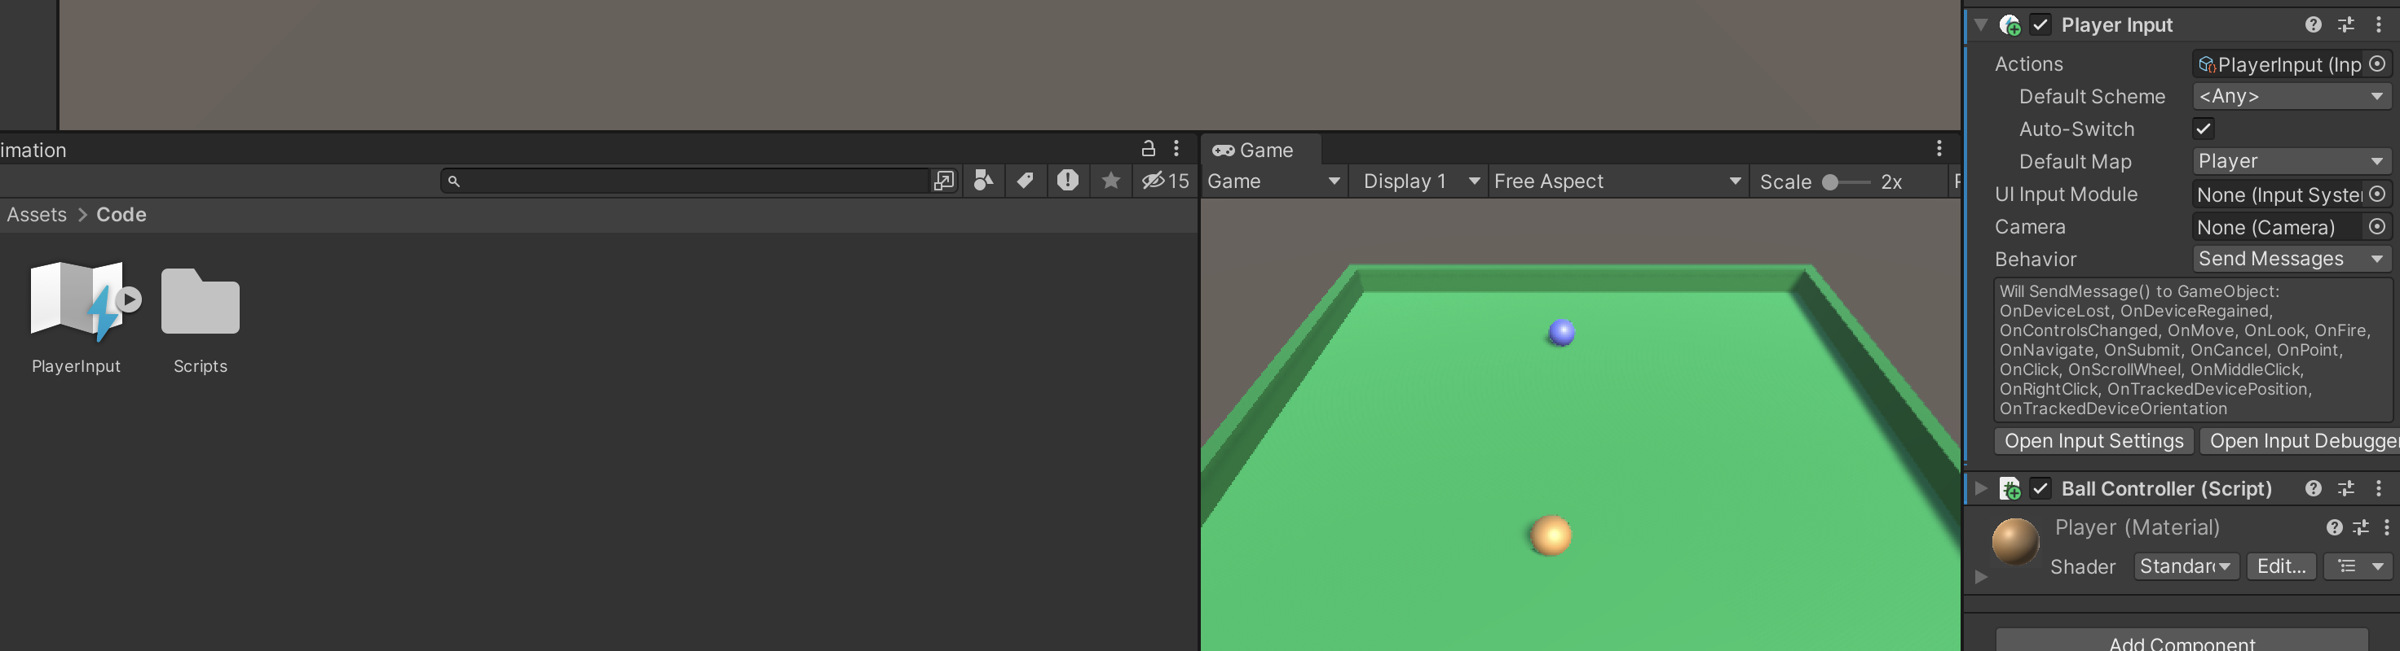
Practical C
Add Player Input component to Player.
Select ‘Player’ GameObject, click Add Component button, choose Player Input
Add Action to Player Input component by select Assets > Create > Input Action. Rename this asset to PlayerInput. Drag and drop input action asset to Action field of Player Input component

Slide 21
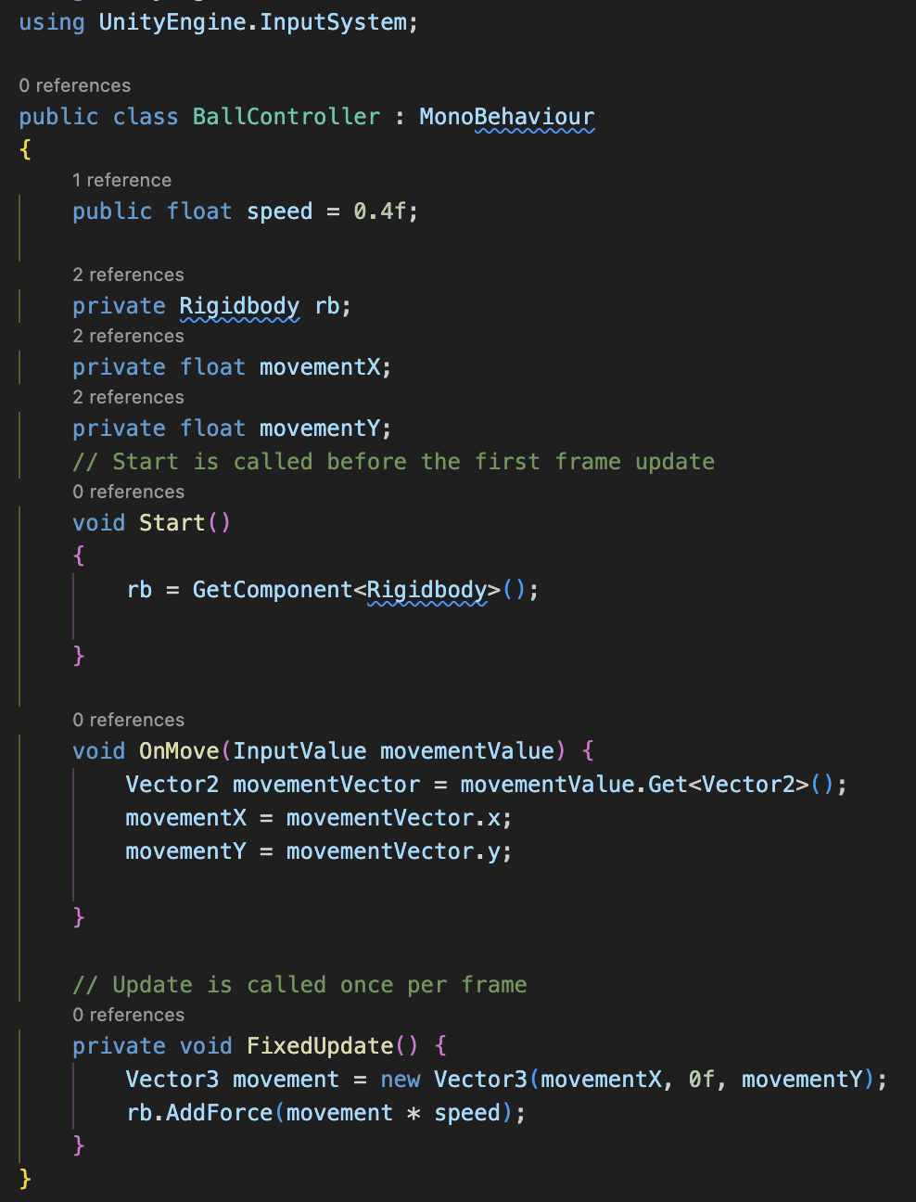
Practical C
Create and add C# script to Player game Object
Select Assets > Create > C# script, rename script to ‘Player Controller’. Add following code to C# script.
Drag and drop ‘Player Controller’ script to Inspector panel of Player object.

Slide 22
Conclusion and Next Steps
We explored Unity's physics engine and the vital use of colliders in collision detection.
Understanding the importance of physics in gaming.
Covered key concepts and practical implementations, providing a foundational understanding for creating engaging experiences while emphasizing best practices in Unity's physics integration.

Slide 23
References
1: Hocking, Joseph; Schell, Jesse, Unity in action: multiplatform game development in C#, 2022
3: Geig, Mike, Sams teach yourself Unity Game development in 24 hours, 2014
6: Gibson Bond, Jeremy, Introduction to Game Design, Prototyping, and Development: From Concept to Playable Game with Unity and C,
8: Unity Technologies, Unity Manual, 2023
10: Goldstone Will, Unity 3.x game development essentials, 2011

